Slide 1
A researcher is investigating a flowering plant. The purple flower allele, P, is dominant to the white flower allele, p. A cross was performed between a purple-flowered plant and a white-flowered plant. The 206 seeds that were produced from the cross matured into 124 purple-flowered plants and 82 white-flowered plants. Calculate the chi-square for if the purple-flowered parent plant was heterozygous.

Slide 2
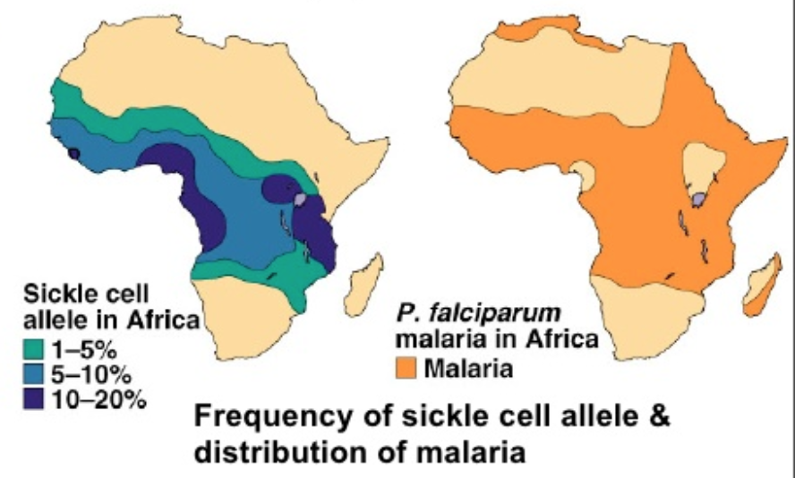
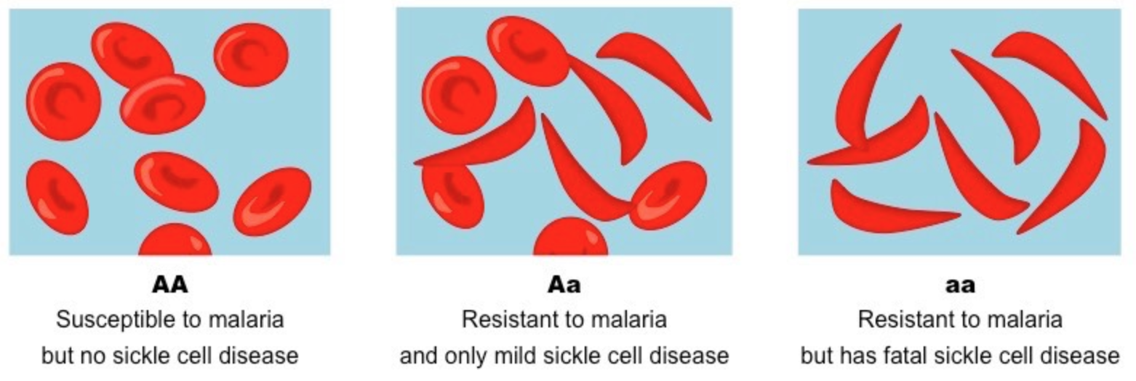
Fun genetics fact of day – The Heterozygous Advantage Hypothesis
The heterozygote genotype has a higher relative fitness than either homozygous genotype
Why is sickle cell anemia prevalent in areas with high malaria??
Those with cystic fibrosis are believed to have a natural resistance to Typhoid Fever

Slide 3
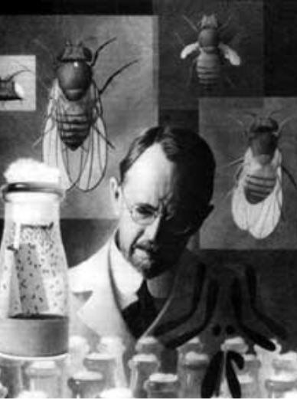
The Chromosomal Basis of Inheritance
Dr. Keller
Chapter 15
Mr. Anderson’s Mendelian Genetics: https://www.youtube.com/watch?v=NWqgZUnJdAY
Mr. Anderson on Punnett Squares: https://www.youtube.com/watch?v=Y1PCwxUDTl8
Mr. Anderson on Chromosomal Inheritance: https://www.youtube.com/watch?v=KaxSDryqB6M

Slide 4
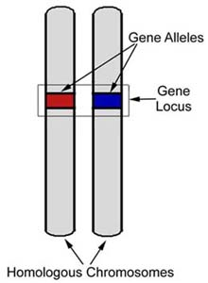
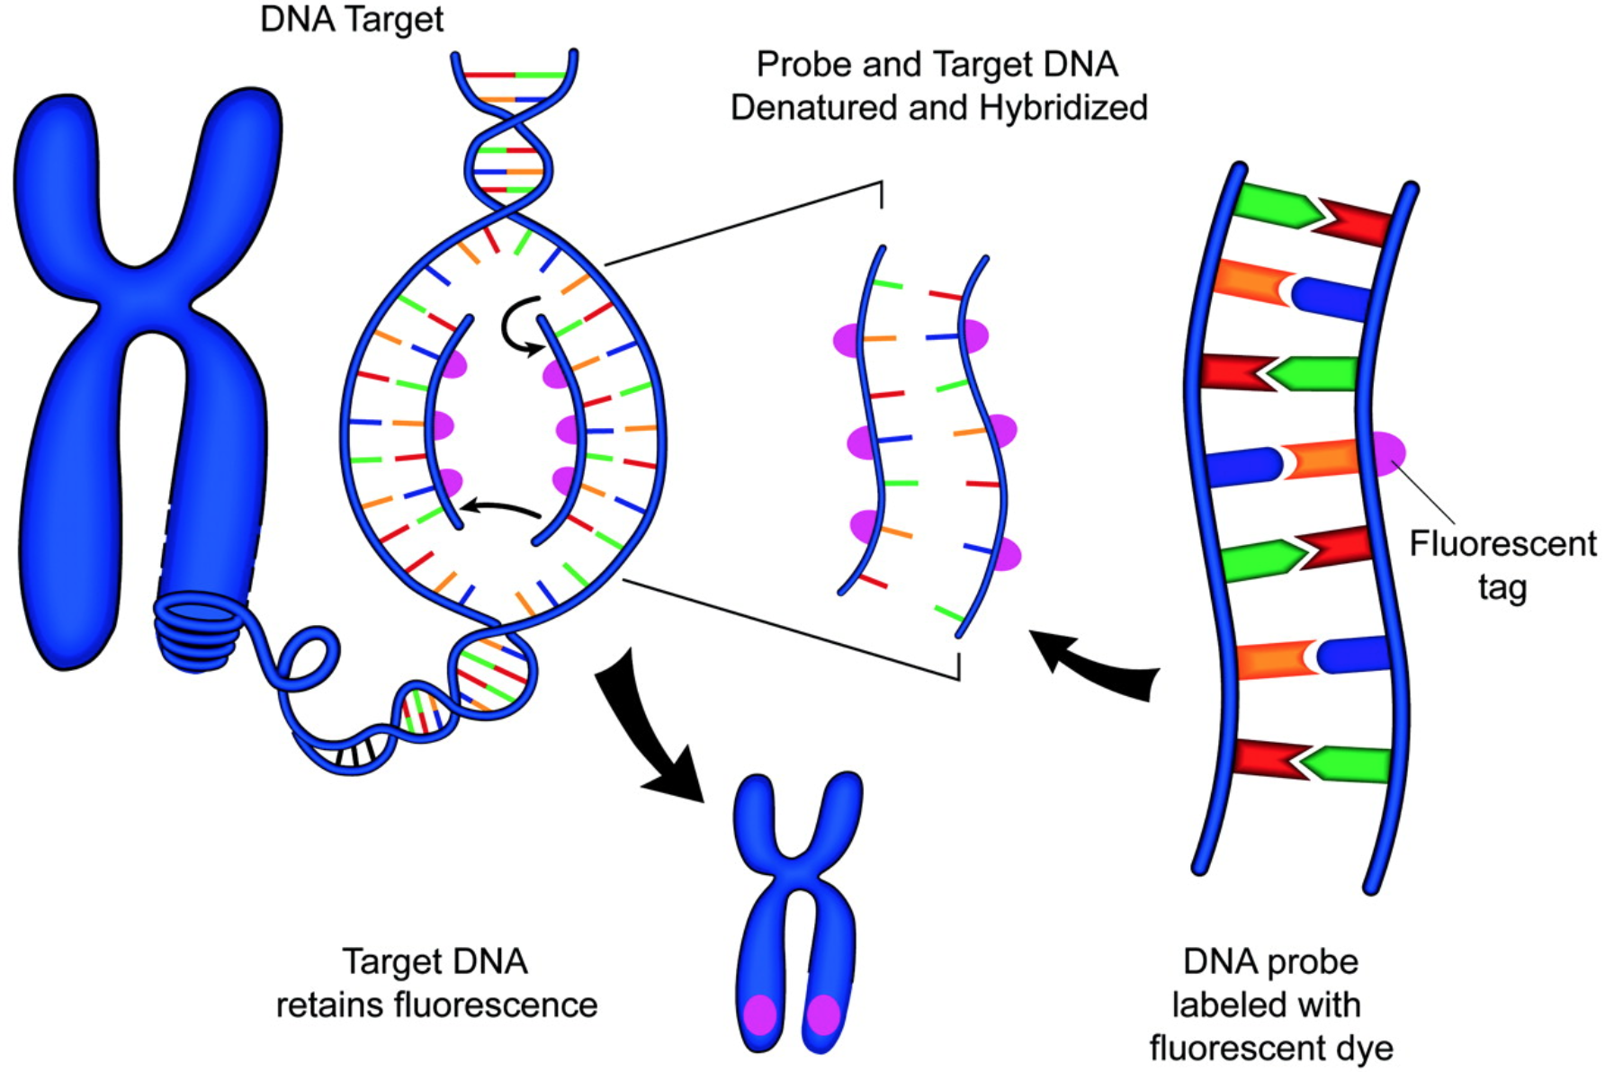
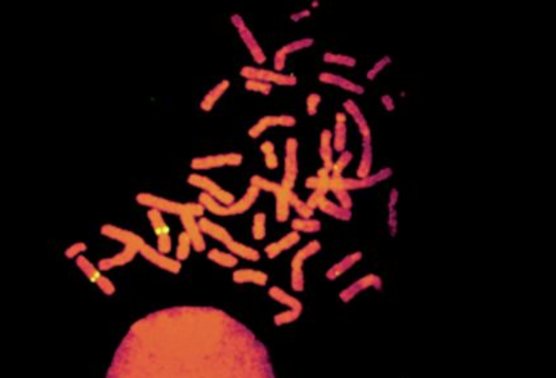
Mendel left us with “hereditary factors”
Now: genes located on chromosomes
We can “see” a gene by tagging chromosomes with fluorescent dyes attached to complementary sequences
Why are there four yellow dots in this image?
Notes:
Fluorescent In Situ Hybridization (FISH) technique to help identify the location of genes on chromosomes
The four yellow dots mark the locus (location) of a specific gene on the sister chromatids of a homologous pair of replicated human chromosomes

Slide 5
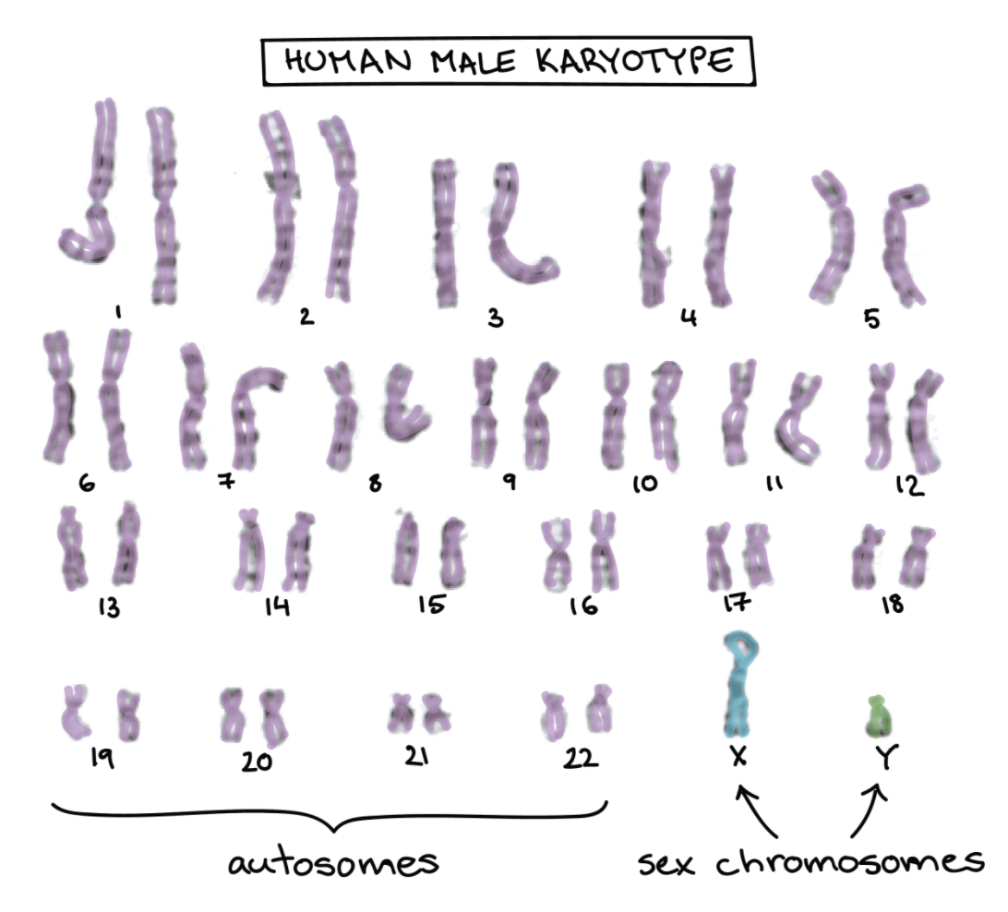
A Human Male Karyotype
Sex determination in humans
Female: XX
Male: XY
Because sex chromosome don’t always come in homologous pairs, the genes they carry show unique, distinctive patterns of inheritance
Notes:
There are other methods of sex determination (see page 290 in your textbook)
The X-Y system: offspring sex determined by whether the sperm has an X or a Y chromosome
The X-0 system: no Y chromosomes. If XX → female; if X → male
The Z-W system: sex chromosomes present only in egg determine sex. ZW → female; ZZ → male
The haplo-diploid system: no sex chromosomes. If unfertilized egg → male (haploid); fertilized egg → female (diploid)

Slide 6
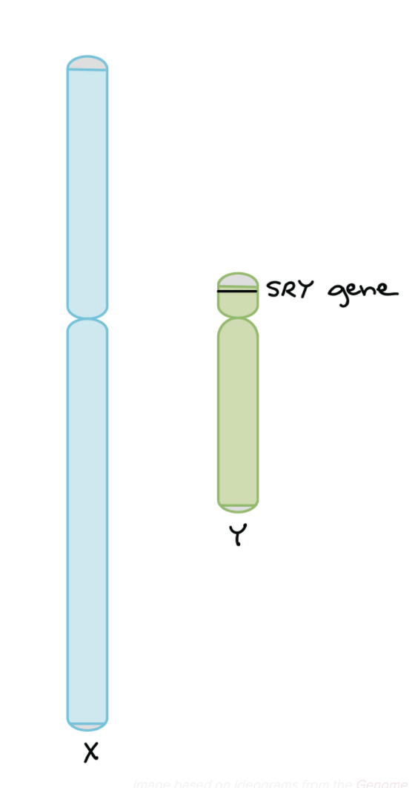
The X chromosome has MANY genes
(only some are involved in sex determination)
The X-chromosome has 800-900 genes with a wide range in functions.
The Y-chromosome has 60-70 genes, about half of which are active only in the testes. The SRY gene acts as a “master switch” as it encodes a protein that turns on other genes required for male development.
XX → no SRY → develop as female
XY → SRY → develop as male
Notes:
SRY = “sex-determining region of Y”
Default setting for human embryonic development is to become female (hence male nipples!)
SRY is a ’master switch’ which produces a transcription factor that switch on other genes that control development of male genitalia and male characteristics

Slide 7
What is the sex of the person if:
Two X chromosomes, but one had a translocation of SRY to an X-chromosome
Have X and Y chromosomes but the SRY has been deleted from the Y-chromosome
Notes:
XX male due to SRY translocated to X
XY female due to SRY deleted from Y

Slide 8
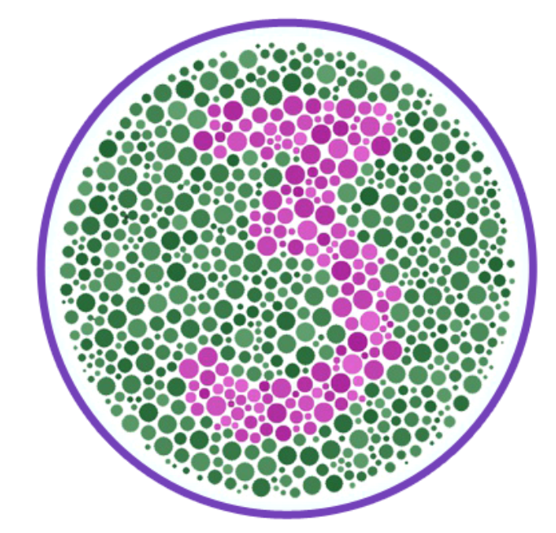
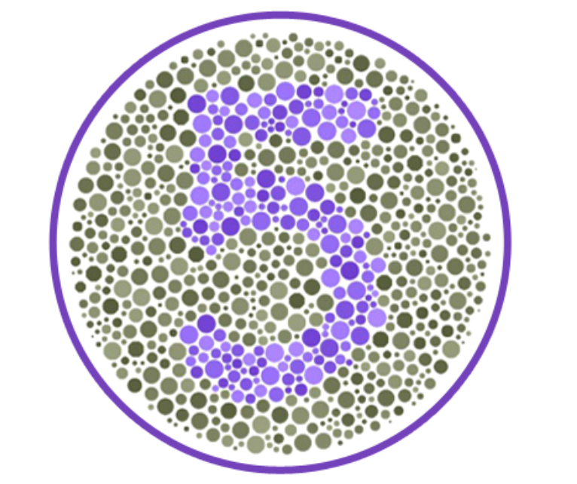
X-linked genes
When a gene is on the X-chromosome, but not the Y chromosome it is said to be X-linked.
Ex: Human color-blindness is an X-linked trait
http://enchroma.com/test/instructions/
Females:
X^{B}X^{B} = dominant normal vision
X^{B}X^{b} = dominant normal vision
X^{b}X^{b} = recessive color blind
Males:
X^{B}Y = dominant normal vision
X^{b}Y = recessive color blind

Slide 9
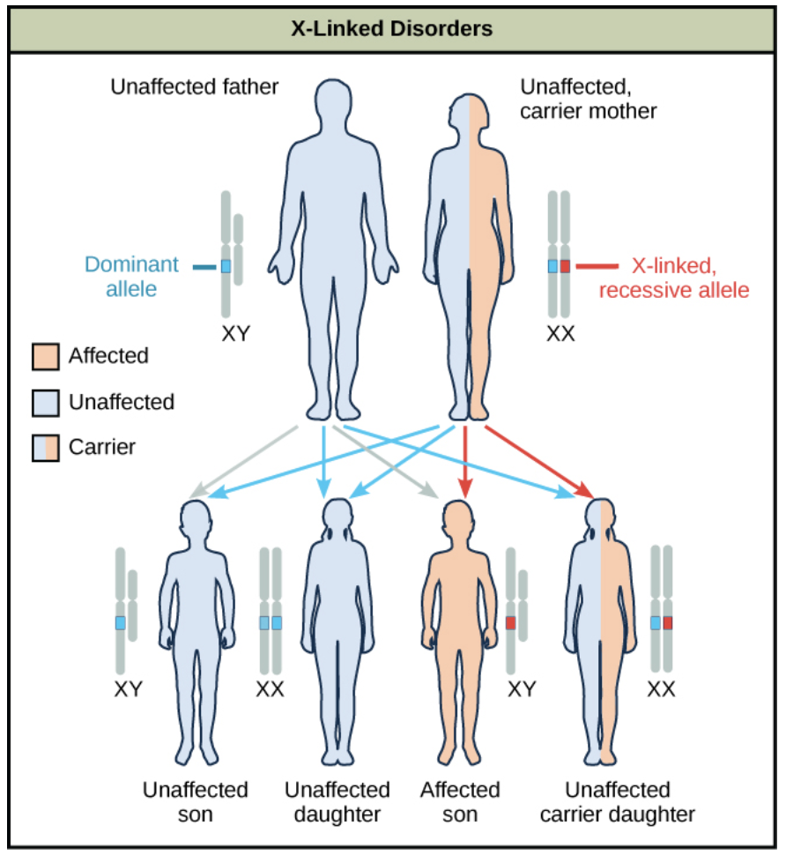
X-linked human genetic disorders
X-linked diseases are much more common in men than they are in women. If a man has an affected X they have the disease!
Females:
X^{B}X^{B} = unaffected
X^{B}X^{b} = unaffected
X^{b}X^{b} = affected
Males:
X^{B}Y = unaffected
X^{b}Y = affected

Slide 10
What are the chances of a color blind male having a color blind daughter if mom was a heterozygote?
If a man and a woman produced a color blind son, does the dad have to be color blind? Where did the son get his affected X chromosome from?
Notes:
XbY crossed to XBXb → ¼ (but 1/2 if it is already a daughter)
No, X chromosome is from mom, because Y is from dad.

Slide 11
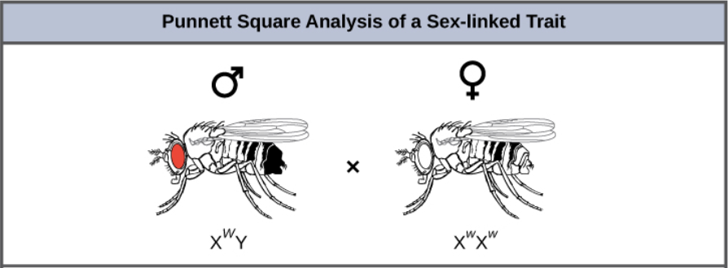
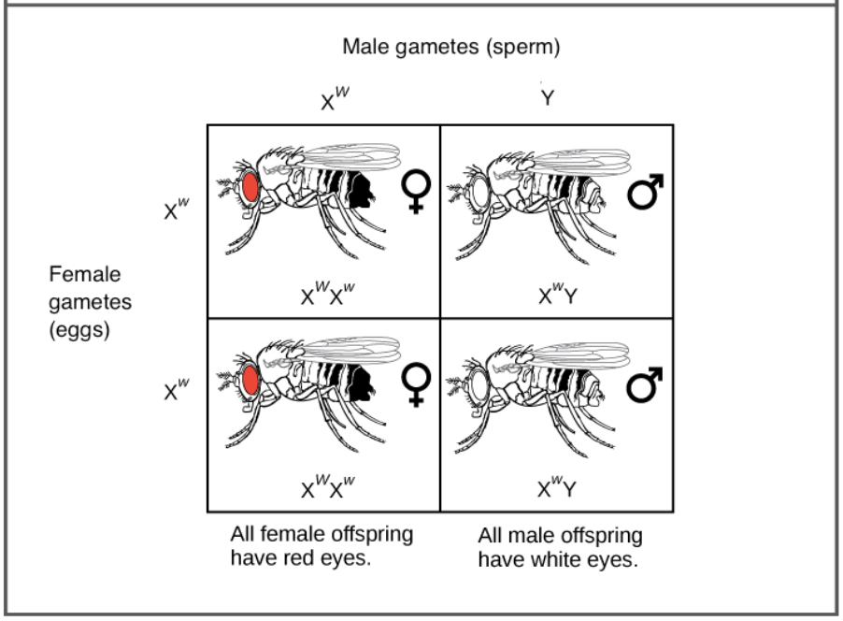
Introduction to fly genetics:
https://www.youtube.com/watch?v=zloG5hSEYNk
Males can only get an X-chromosome from their mothers (because Y from dad)
If the gene is X-linked and mom has the recessive phenotype (white eyes) ALL male offspring have white eyes and none of the females.

Slide 12
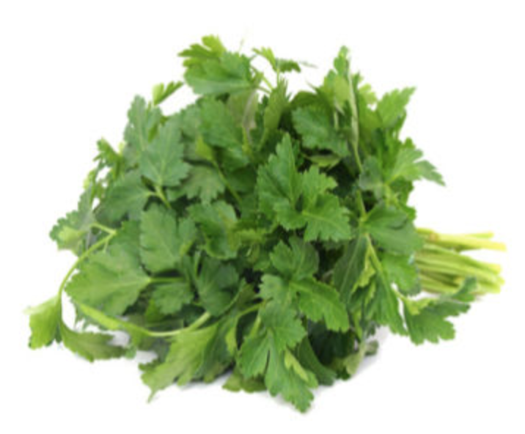
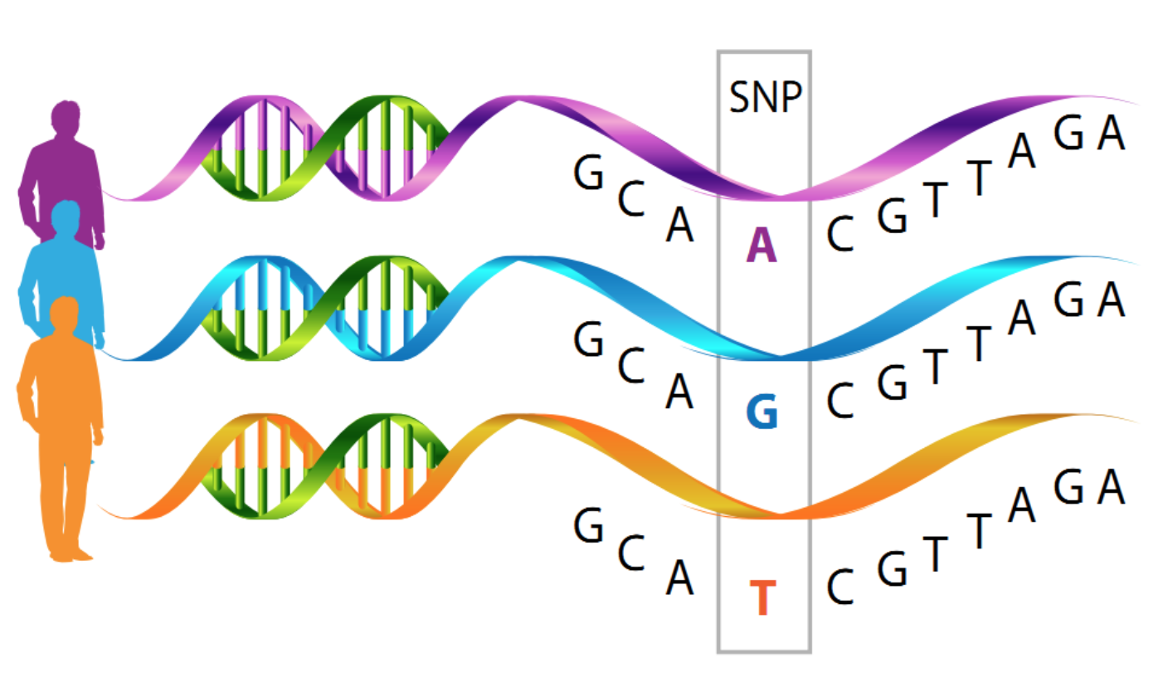
Fun Genetics Fact of the day
Raise your hand if you HATE cilantro
What does it taste like to you?
Genetic survey of 30,000 people showed this is genetic
An olfactory receptor gene mutation causes this hatred!
A single nucleotide polymorphism (SNP)

Slide 13
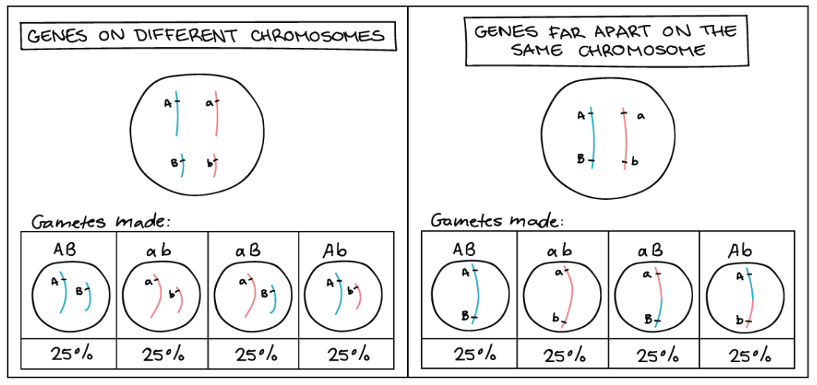
Genetic Linkage
When genes are on separate chromosomes, or very far apart on the same chromosome, they assort independently (gametes are exactly what you would expect from parent)
What is going on here?
Notes:
WHAT GAMETES FROM AbBb? REMINDER OF HOW YOU GET THOSE OPTIONS: MEIOSIS!!
Crossing over occurred!
Crossing over occurs more frequently if genes are VERY far apart

Slide 14
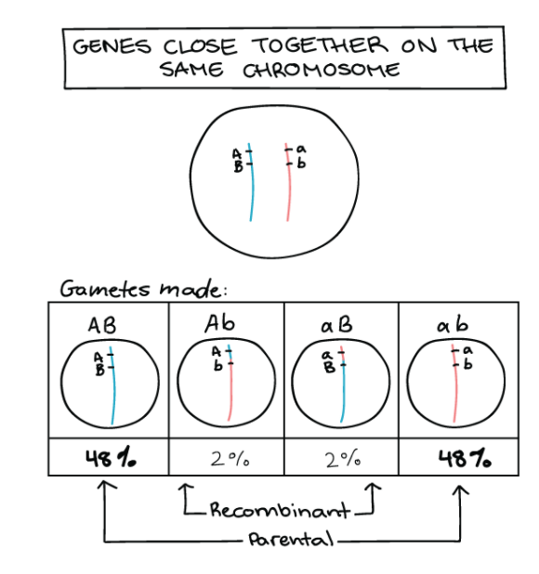
Genetic Linkage
When genes are very close together on the same chromosome instead of assorting independently, the genes tend to “stick together” during meiosis → the genes are LINKED!
Now we see gamete types in very unequal proportions.
Gametes more often look like their parents (parental gametes) but occasionally there was crossing over between the “a” and “b” gene resulting in recombinant gametes

Slide 15
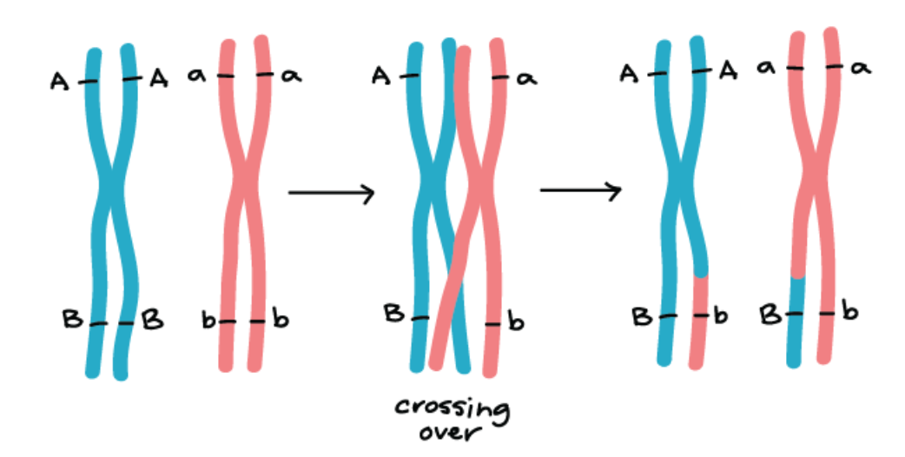
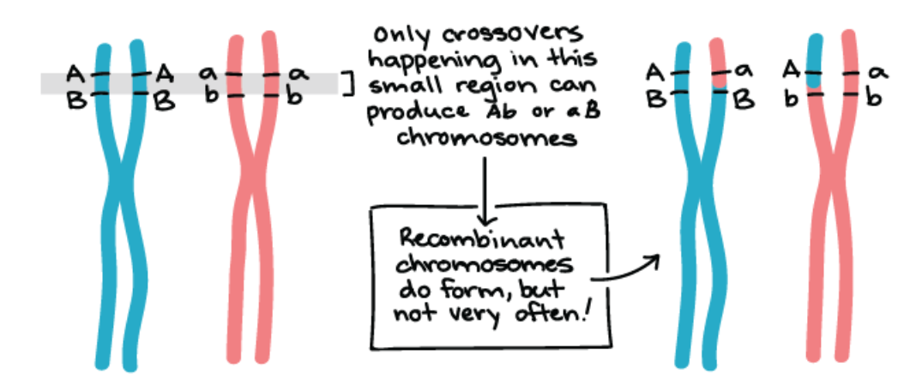
Making recombinant chromosomes by crossing over
(containing a different combination of alleles from either of its parents)
Crossing over between two genes that are far apart is very common
Crossing over between two genes that are close together is rare
Thomas Hunt Morgan used this as a way to find the relative distance between genes on a chromosome
Tightly linked genes (genes very close to each other) will have very few recombination events, while unlinked genes (genes on separate chromosomes or very far part) will show a lot of recombination.

Slide 16
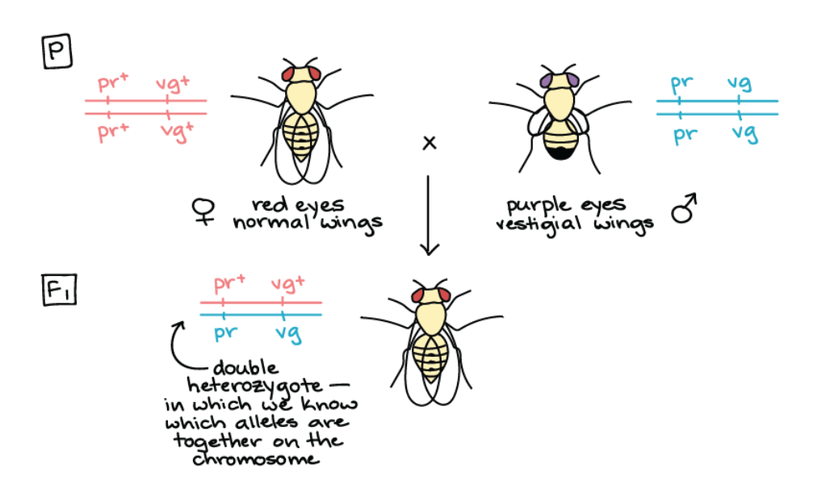
Calculating Recombination Frequency
Goal: Determine whether two genes in the fruit fly are linked to each other, and if so, how tightly linked are they?
The purple gene:
R → red eyes (dominant)
r → purple eyes
The vestigial gene:
V → normal wings (dominant)
v → short “vestigial” wings
R
V
r
v
R
V
r
v
Need to do a cross from true-breeding recessive flies to observe recombination
Draw the Punnett Square!
R
V
r
v
Notes:
Always start by making a key: RR and Rr = red; rr = purple; VV and Vv = normal; vv = vestigal
Vestigial: forming a very small remnant of something that was once much larger or more noticeable.

Slide 17
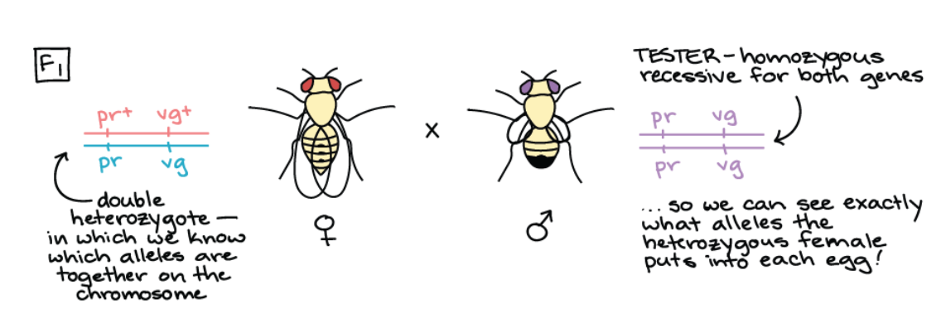
Calculating Recombination Frequency
Goal: Determine whether two genes in the fruit fly are linked to each other, and if so, how tightly linked are they?
The purple gene:
R → red eyes (dominant)
r → purple eyes
The vestigial gene:
V → normal wings (dominant)
v → short “vestigial” wings
R
V
r
v
r
v
r
v
Do a test cross with a known homozygous recessive purple eyed vestigial winged fly. Look at offspring.
DO THIS PUNNET SQUARE → WHAT IS EXPECTED OUTCOME?
Notes:
Pr+prVg+vg crossed to prprvgvg → expect 1:1:1:1 ratio (red normal : red vestigal : purple normal : purple vestigal)
Vestigial: forming a very small remnant of something that was once much larger or more noticeable.

Slide 18
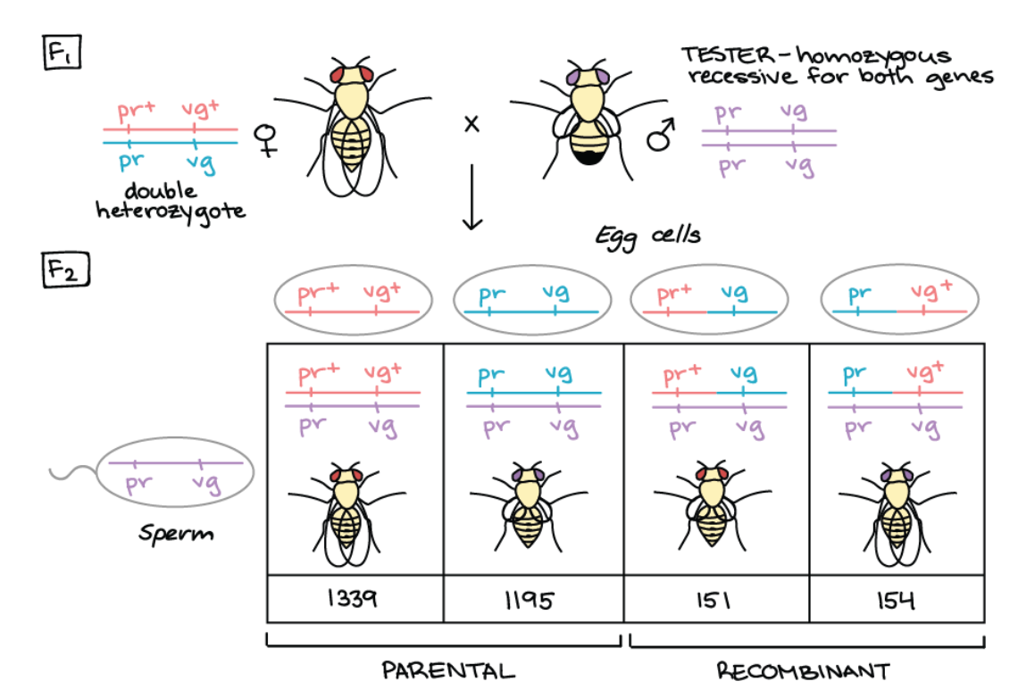

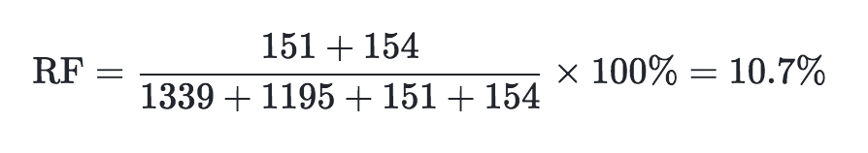
Calculating Recombination Frequency
Goal: Determine whether two genes in the fruit fly are linked to each other, and if so, how tightly linked are they?
Didn’t get the expected 1:1:1:1 ratio → genes are linked!
R
V
r
v
r
v
r
v
R
V
r
v
R
v
r
V
R
V
r
v
R
v
r
V
r
v
r
v
r
v
r
v
Measure the linkage by calculating recombination frequency
r
v
Notes:
The four classes of offspring are not produced in equal numbers, which tell us that the purple and vestigial genes are linked! As expected for linked genes, the parental chromosome configurations are over-represented in the offspring, while the recombinant chromosome configurations are under-represented. To measure linkage quantitatively, we can calculate the recombination frequency (RF) between the two genes.

Slide 19
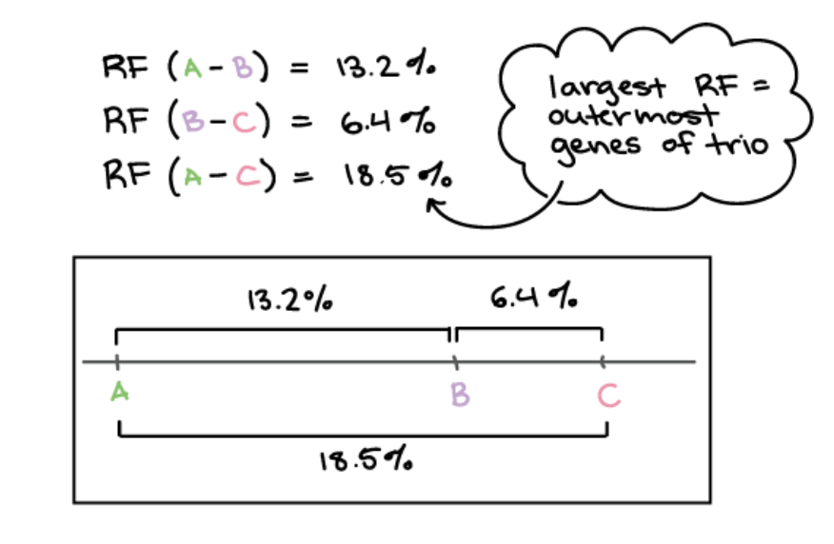
Determining Gene Maps
Goal: Determine whether two genes in the fruit fly are linked to each other, and if so, how tightly linked are they?
13.2%
6.4%
19.6%
A linkage map is a genetic map of a chromosome based on recombination frequencies.
19.6%
Distances between genes can be expressed as map units,
1 map unit = 1 centiMorgan = 1% recombination
Notes:
Map units indicate relative distances and order but not precise locations of genes.

Slide 20
How to determine linkage maps from recombination frequencies?
13.2%
6.4%
19.6%
Do on the board together!
WORKSHEET FOR PRACTICE IS HOMEWORK
The largest RF – outermost genes.
The smallest RF – innermost genes.
Use and logic and reasoning to determine map.

Slide 21
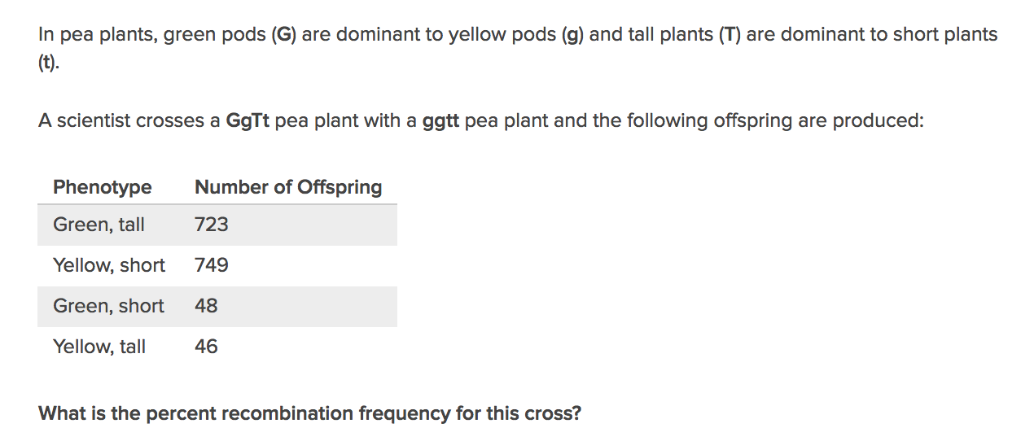
Practice Problem
Notes:
To do this, you first need to determine which are the parental and which are the recombinants.
Recombinants do not look like the parents so (46+48)/total x100 = 94/1566 x 100 = RF = 6%

Slide 22
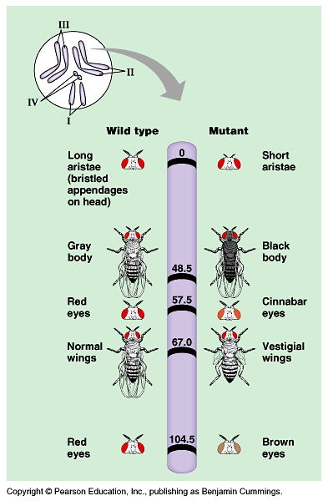
The fruit fly genetic map
Morgan and his team did this for thousands of genes in the fruit fly genome. Invented techniques used in human genetics!

Slide 23
Wildtype flies have normal wings (over vestigial wings) and tan bodies (over black bodies).
Male homozygous wildtype flies were crossed with homozygous females with vestigial wings and black bodies to produce offspring with only normal wings and tan bodies.
These F1 offspring were then crossed with homozygous recessive flies and gave the following observations:
537 tan bodies, normal wings
101 tan bodies, vestigial wings
101 black bodies, normal wings
533 black bodies, vestigial wings
Are these significantly different than your expected numbers?
If so what is a possible reason?
How closely are these genes linked?
Notes:
Chi square: 592 → REJECT
RF = 16%

Slide 24
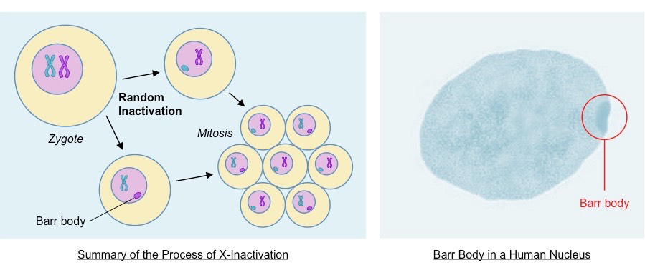
X-Inactivation in Female Mammals
For most chromosomes, having an extra or missing copy is lethal to humans
But human females have two X-chromosomes (XX), while human males have just one (XY).
Inactivation of gene expression one of the
X-chromosomes to form a Barr body
Inactivated X-chromosome
Notes:
In X-inactivation, an X chromosome is compacted, to make a small, dense structure called a Barr body. Most of the genes on the Barr body are inactive, meaning that they are not transcribed.
X-INACTIVATION ONLY OCCURS IN SOMATIC DIPOID CELLS POSSESSING 2 X-CHROMOSOMES!

Slide 25
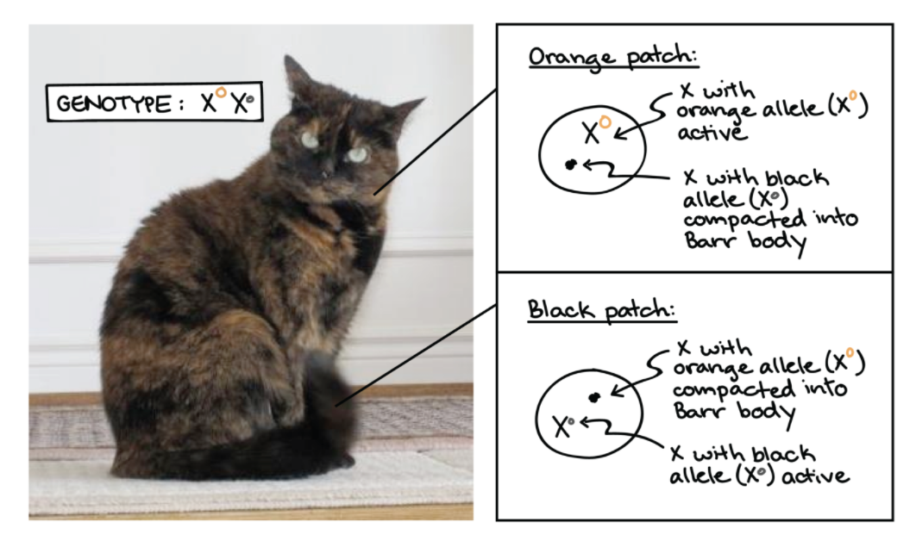
X-Inactivation in Calico cats
Here is a female cat heterozygous for black and tan alleles of a coat color gene found on the X-chromosome.
Random X-inactivation in different cells during development causes a tortoiseshell coat pattern.
Notes:
All truly calico cats are female!!

Slide 26
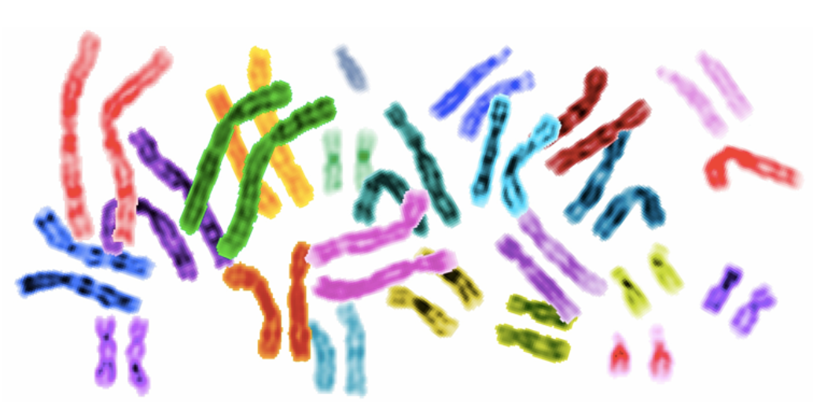
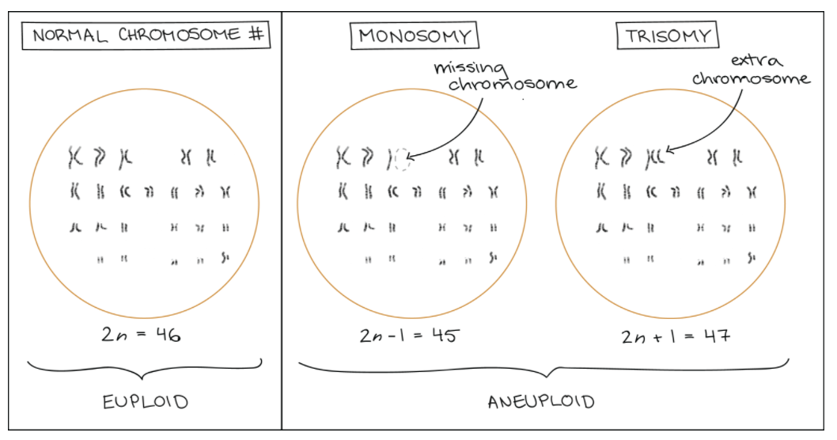
Nondisjunction (bad separation) during Meiosis
Pairs are important in genetics!
If a chromosome pair loses or gains a member → trouble!
Anueploidy
having an abnormal number of chromosomes (too many or too few!)

Slide 27
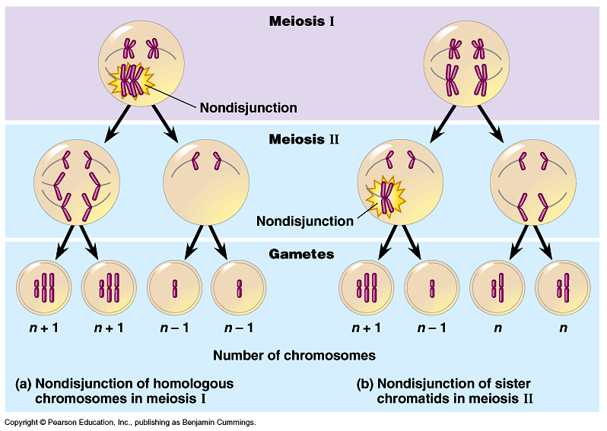
Nondisjunction in Meiosis results in aneuploidy
Try drawing out both types of nondisjunction: starting cell AaBb
Notes:
Nondisjunction: the failure of one or more pairs of homologous chromosomes or sister chromatids to separate normally during nuclear division, usually resulting in an abnormal number of chromosomes in the daughter nuclei.

Slide 28
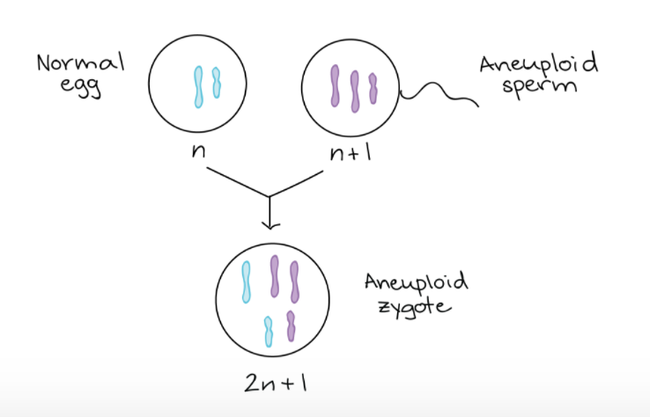
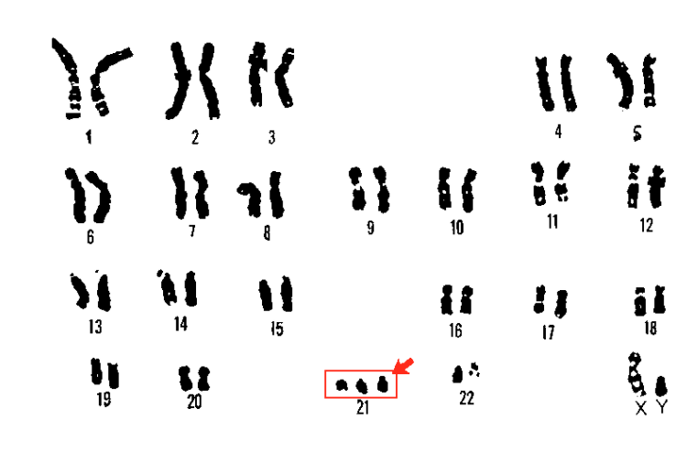
Nondisjunction in Meiosis results in aneuploidy
About 1 in every 800 newborns is born with Down’s syndrome. This goes up with maternal age.

Slide 29
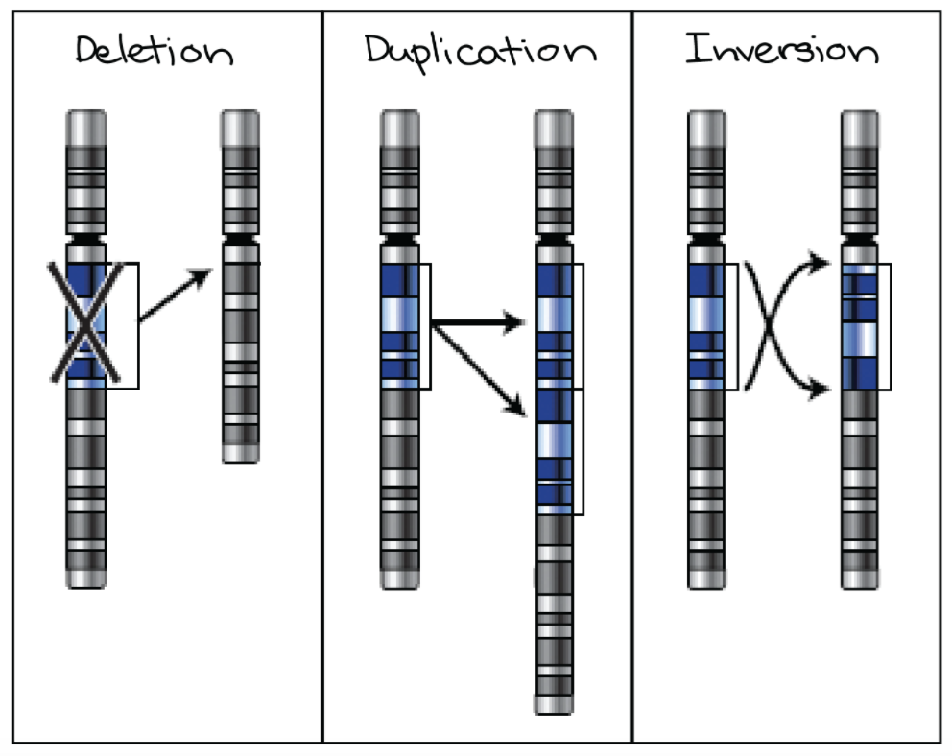
Chromosomal Rearrangements
Inversion
A chromosomal region is flipped around so that it points in the opposite direction
Deletion
A part of a chromosome is removed or deleted
Duplication
A part of a chromosome is copied
Also translocation (next slide)
Notes:
Deletion mutations occur when part of a DNA molecule is not copied during DNA replication. This uncopied part can be as small as a single nucleotide or as much as an entire chromosome.
Duplications typically arise from an event termed unequal crossing-over (recombination) that occurs between misaligned homologous chromosomes during meiosis (germ cell formation). The chance of this event happening is a function of the degree of sharing of repetitive elements between two chromosomes.
An inversion occurs when a single chromosome undergoes breakage and rearrangement within itself.

Slide 30
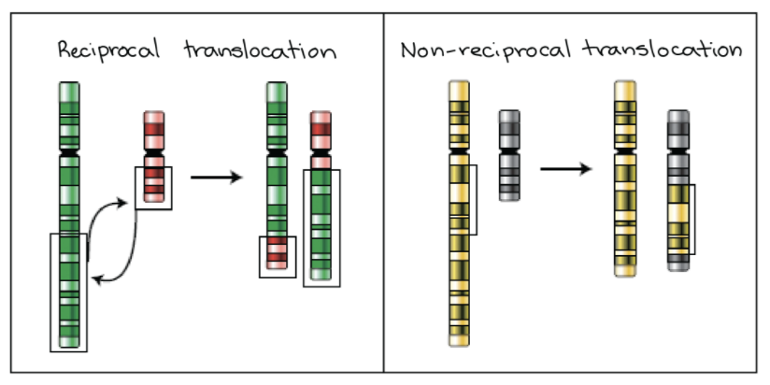
Chromosomal Rearrangements
Reciprocal Translocation
Involves two chromosomes swapping segments
Translocation
A piece of a chromosome gets attached to another chromosome
Non-Reciprocal Translocation
A chunk of one chromosome moves to another
Notes:
Chromosome translocation is a chromosome abnormality caused by rearrangement of parts between non-homologous chromosomes. A gene fusion may be created when the translocation joins two otherwise-separated genes, it can be detected on a karyotype of affected cells.

Slide 32
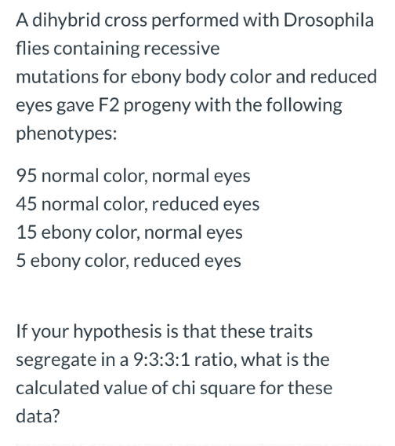
Practice
Null hypothesis?
Degrees of Freedom?
Possible explanation?
Notes:
Null hypothesis: There is no significant different between the expected and the observed numbers of offspring.
Df: 4-1 = 3
Possible Explanation: Maybe there is some gene linkage?? Maybe the male flies weren’t flying so well…
Chi Square: expected: (9/16 x 160 = 90; 3/16 x 160 = 30 and 30; 1/16 x 160 = 10) observed: 95 45 15 5
0.278 + 7.5 + 7.5 + 2.5 = 17.78

Slide 33
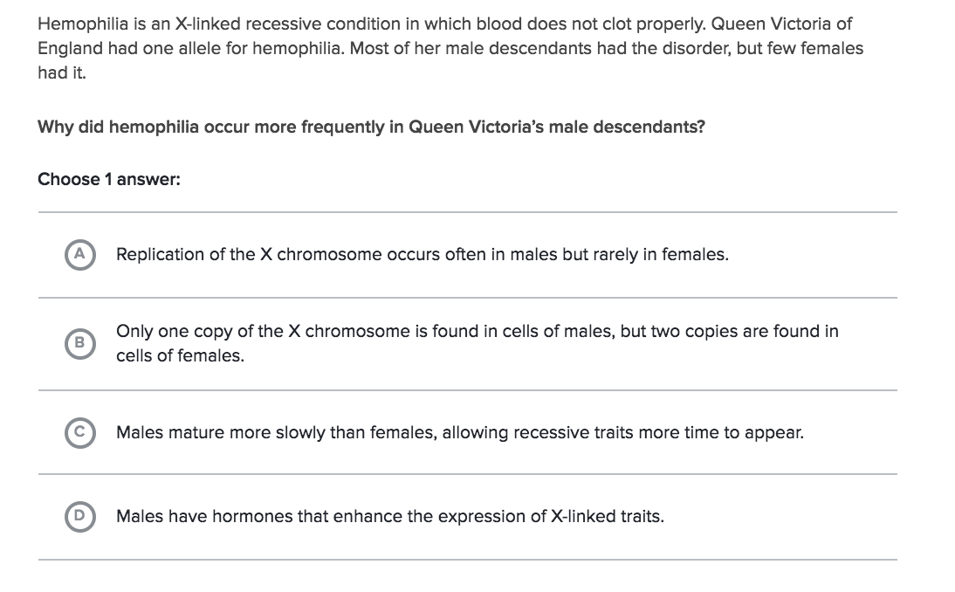
Practice Problems
Notes:
1- B

Slide 34
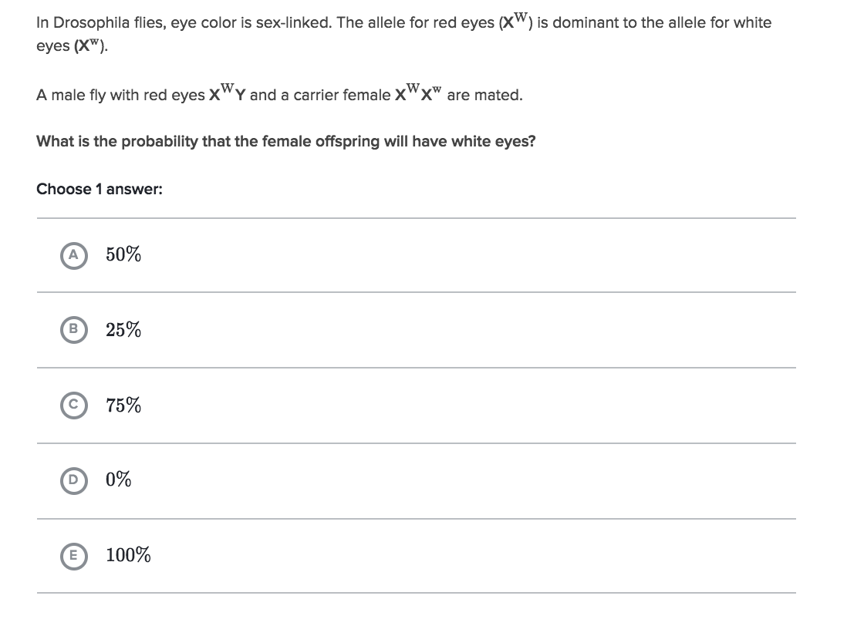
Practice Problems
Notes:
2- D

Slide 35
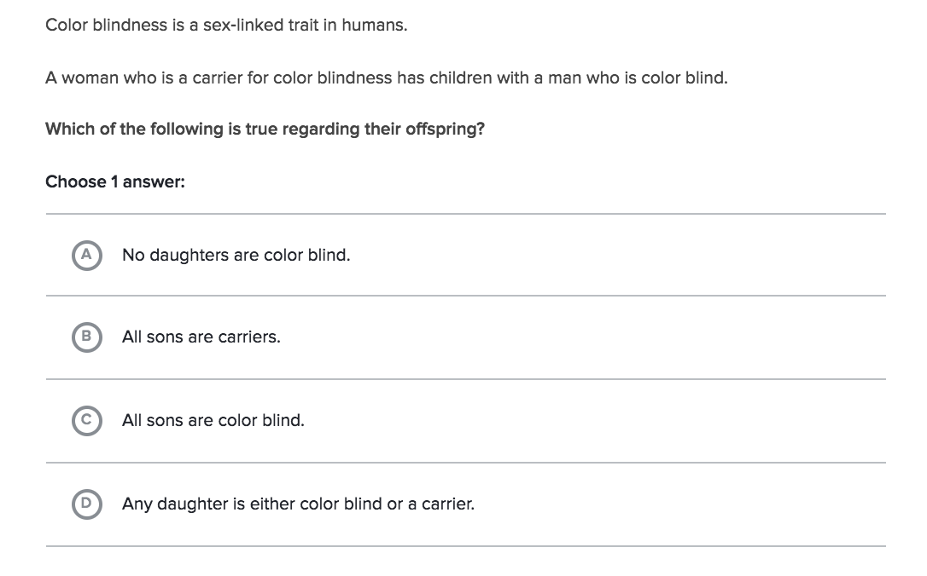
Practice Problems
Notes:
3- D

Slide 36
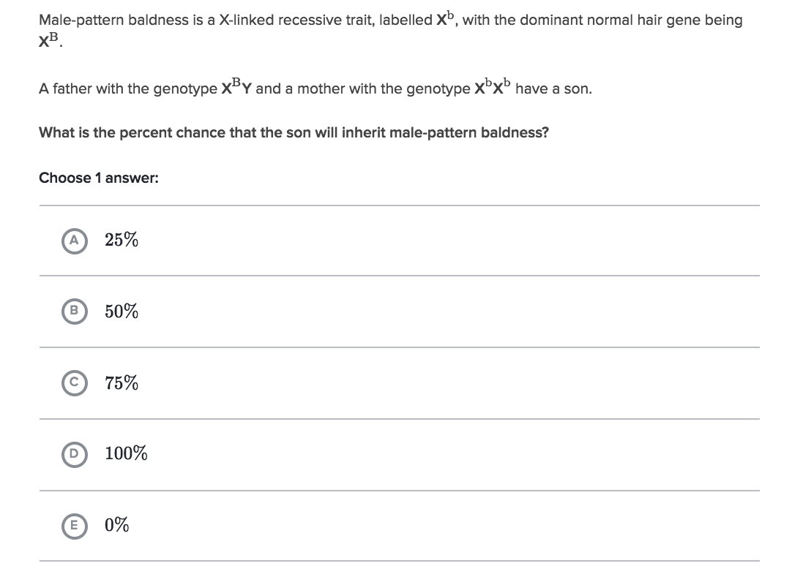
Practice Problems
Notes:
4- D

Slide 37
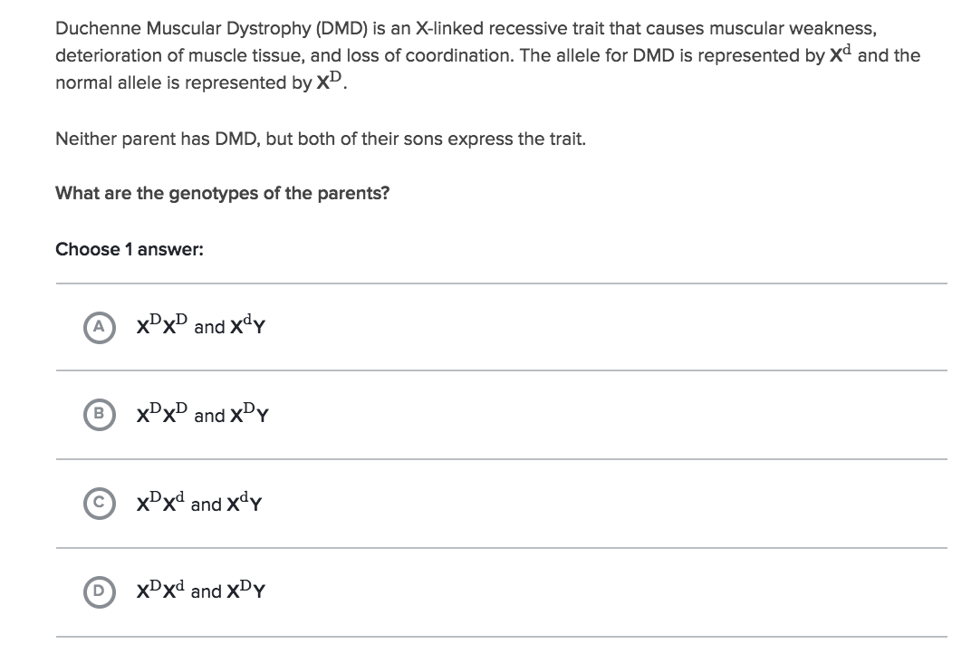
Practice Problems
Notes:
5- D

Slide 38
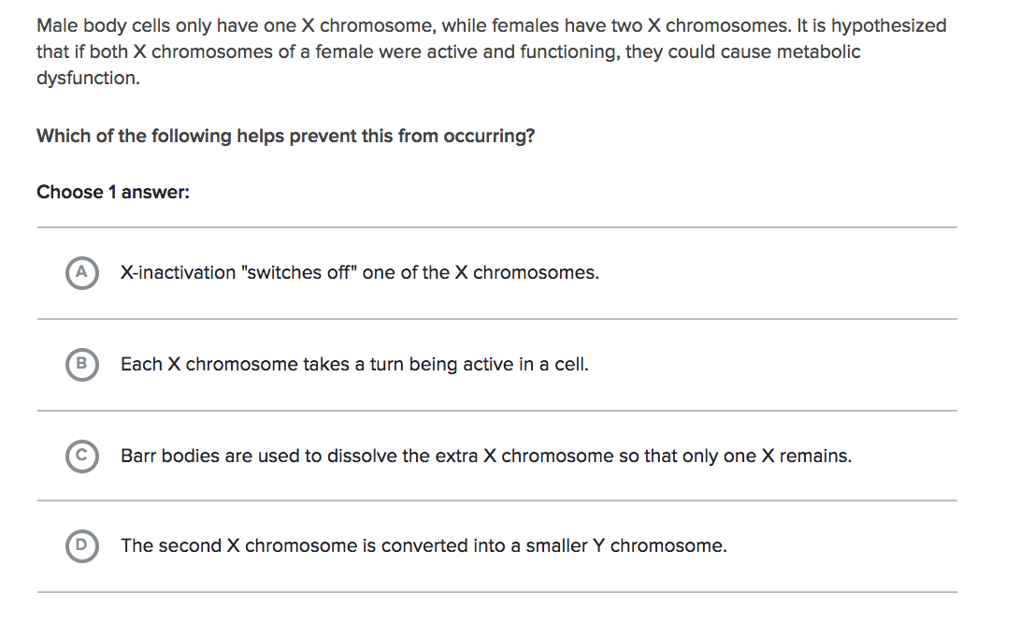
Practice Problems
Notes:
6- A

Slide 39
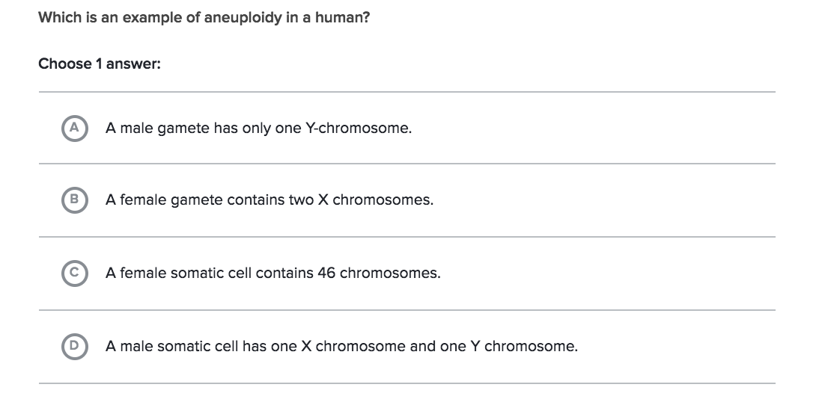
Practice Problems
Notes:
7- B

Slide 40
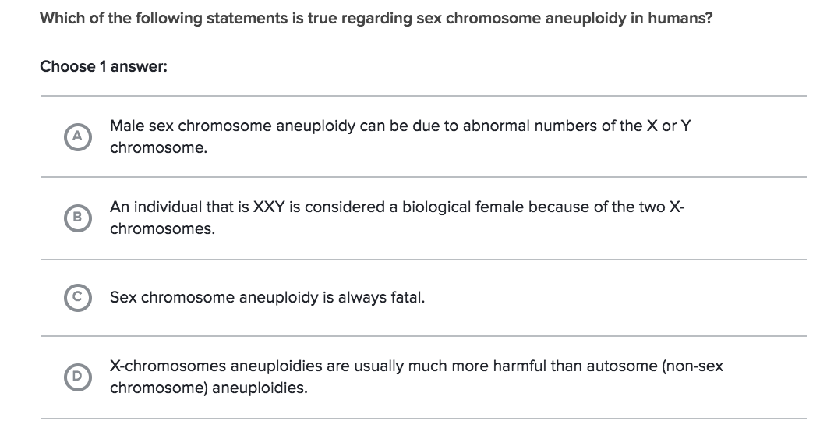
Practice Problems
Notes:
8- A

Slide 41
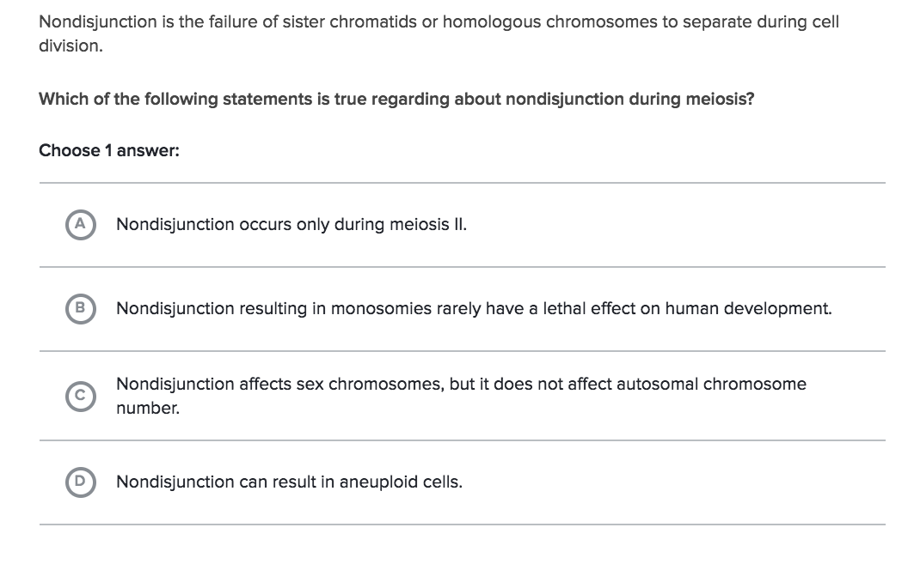
Practice Problems
Notes:
D

Slide 42
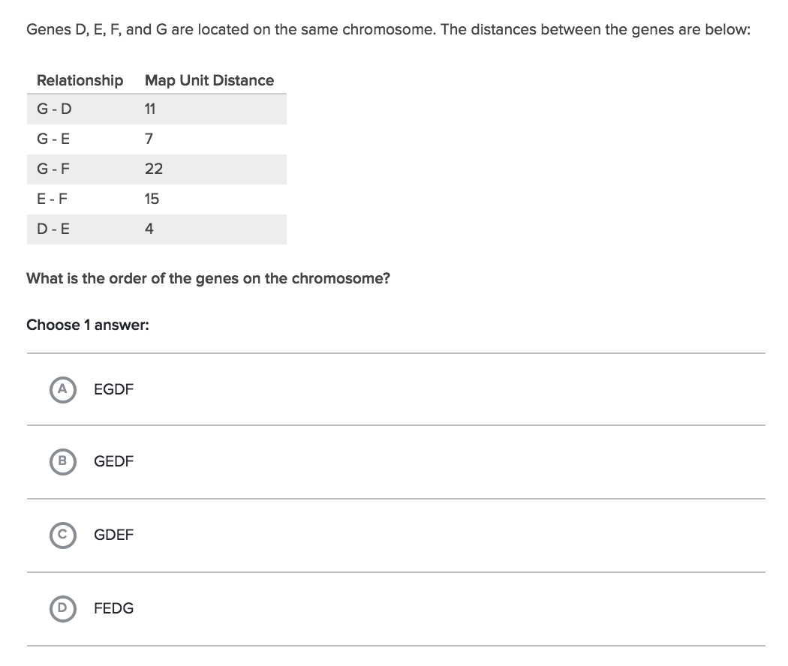
Practice Problems
Notes:
B- hard one! Try all the combinations. I started with the smallest distances first.

Slide 43
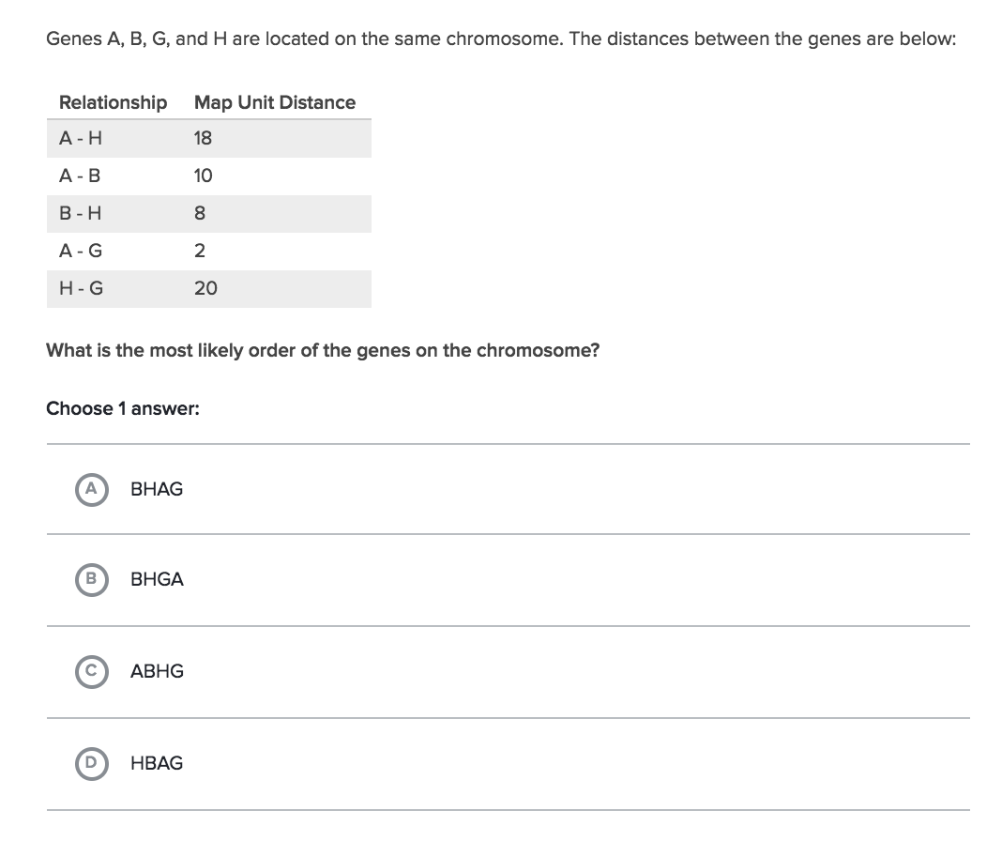
Practice Problems
Notes:
D

Slide 44
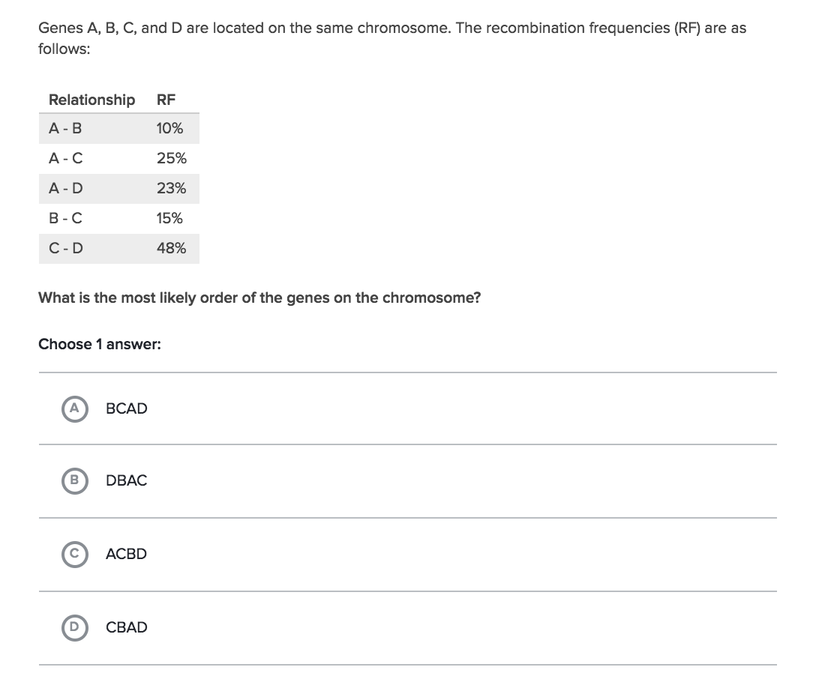
Practice Problems
Notes:
D

Slide 45
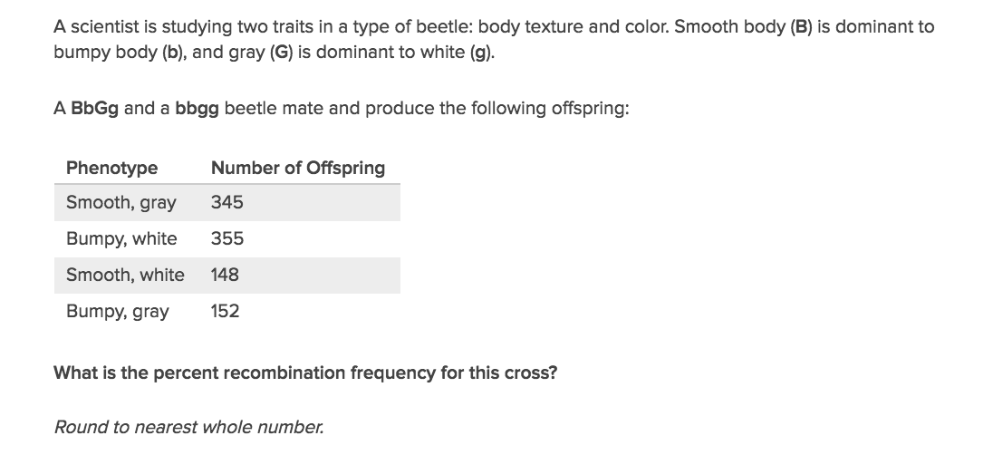
Practice Problems
Notes:
30%

Slide 46
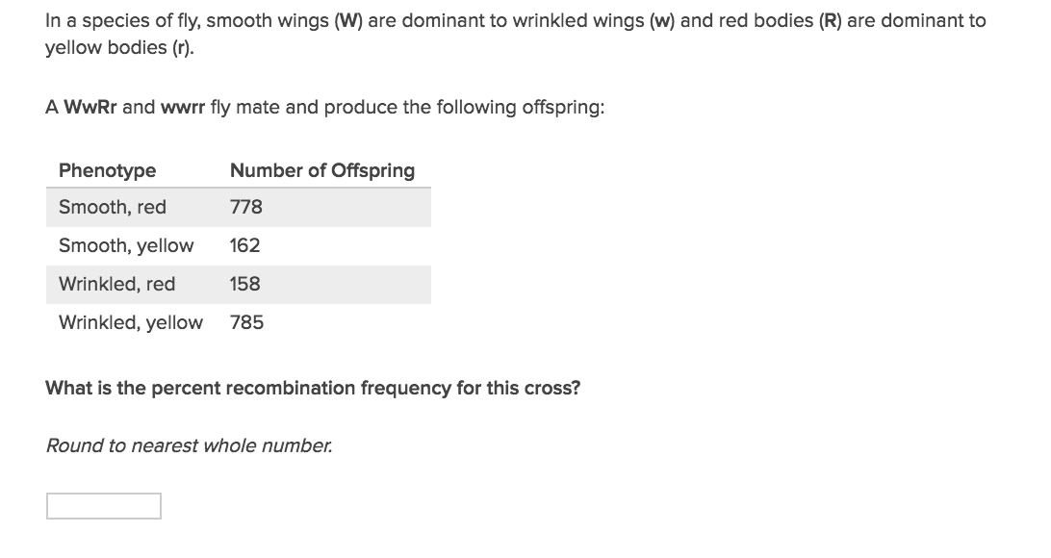
Practice Problems
Notes:
17

